Slide 1
Scan Global X HDAG Final Presentation
Friday, Dec. 8th, 2023
Eliza Knapp, Kevin Cong, Jade Nair, Ben Hartvigsen, Kelly Tung, Ryan Jiang, Russell Li

Slide 2
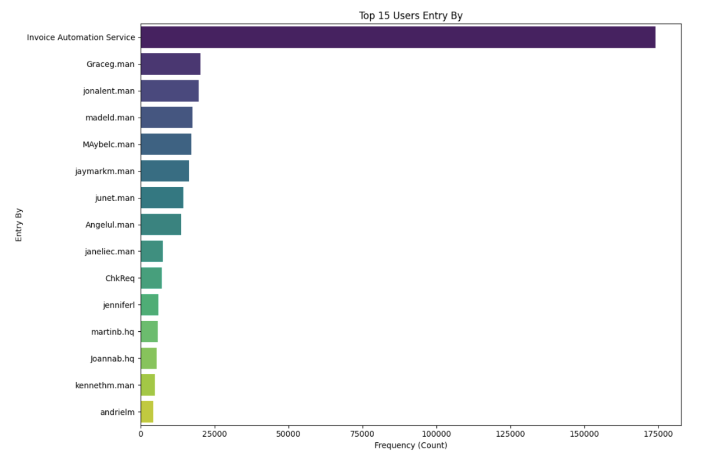
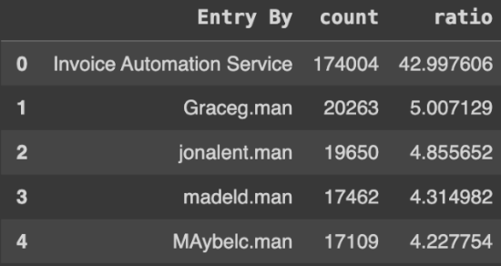
Top 15 “Entry By” Users
analyzed using data from completed invoices
Notable results:
Most entries by Invoice Automation Service
difference by a wide margin compared to other users (42% of all invoices, 174k+ invoices total)
over half of top 15 by people with “.man”
Notes:
Kelly

Slide 3
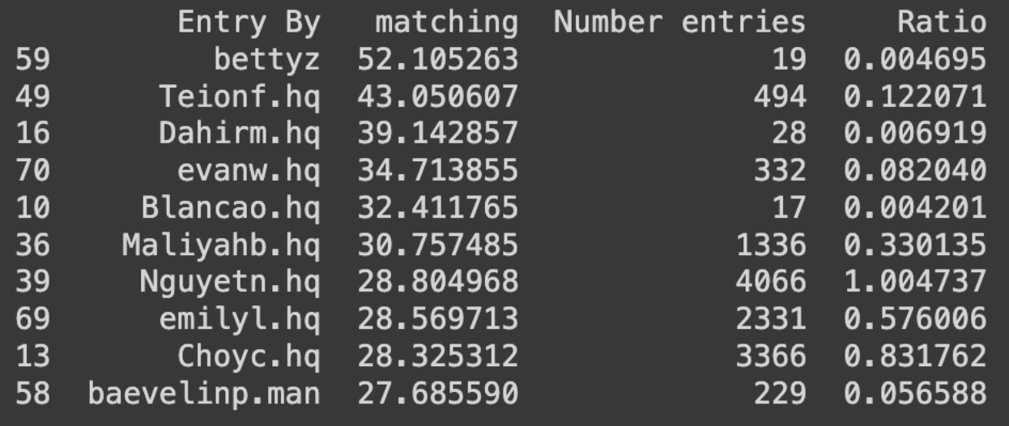
Top 10 Longest Matching Time for “Entry By” Users
analyzed using data from completed invoices
Notable results:
NOTE: ratio is in percentage already
Longest matching time around 52 days
10 day gap between longest and second longest
not huge ratio, so not big concern (<0.005%)
Biggest ratio out of longest is 1% by Nguyetn.hq
Again, not a huge deal bc 1%
Overall, these users add up to less than 2%, so they aren’t hindering processes too much even though there it takes up a lot of time
Notes:
Kelly

Slide 4
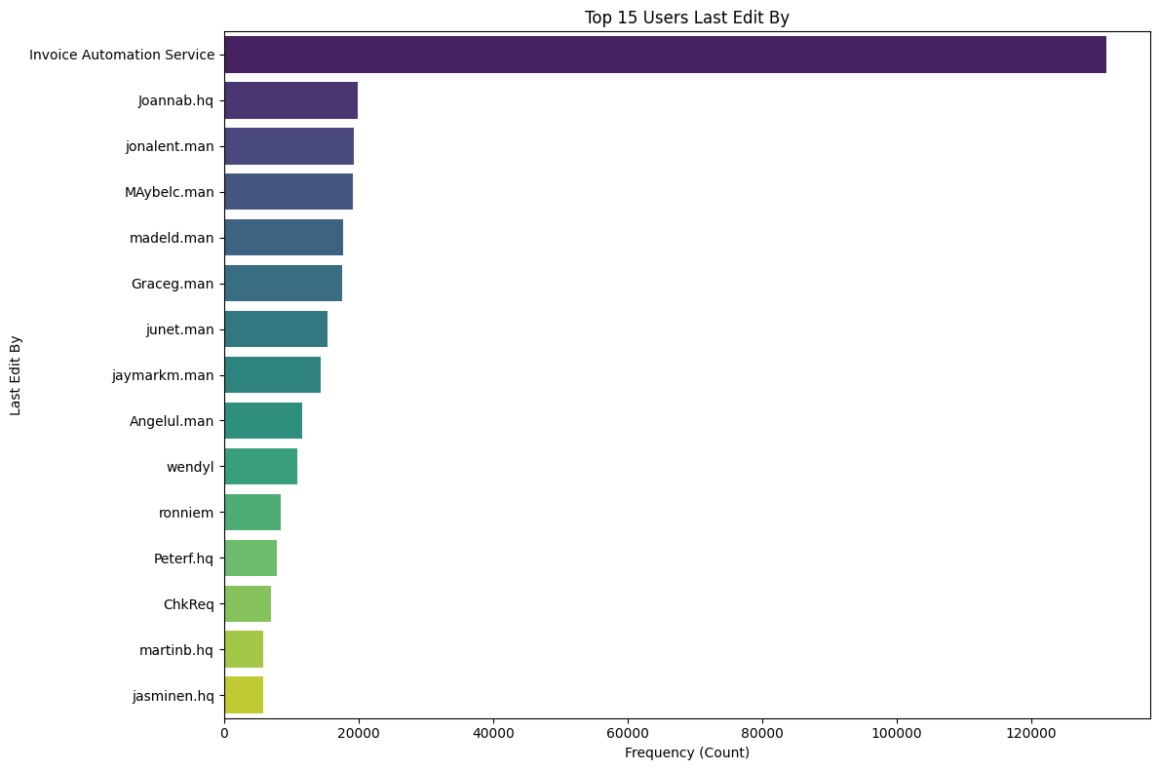
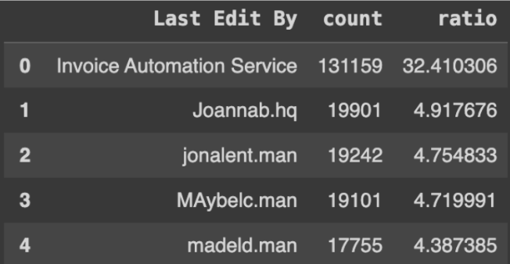
Top 15 “Last Edit By” Users
analyzed using data from completed invoices
Notable results:
Most entries by Invoice Automation Service again
difference by a wide margin compared to other users (32% of all invoices, 131k+ invoices total)
less than “entry by” stats
~half of top 15 by people with “.man”
Notes:
Kelly

Slide 5
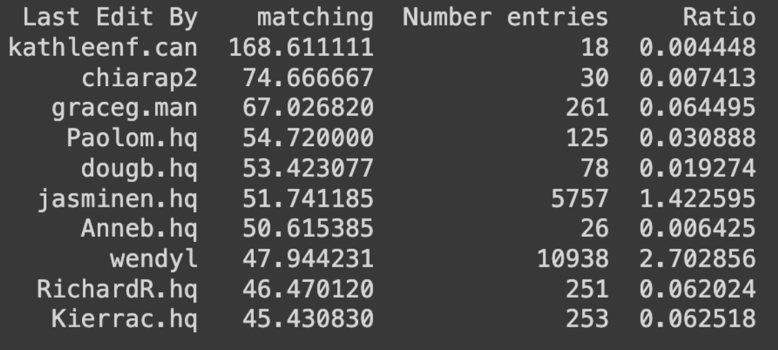
Top 10 Longest Matching Time for “Last Edit By” Users
analyzed using data from completed invoices
Notable results:
NOTE: ratio is in percentage already
Longest matching time around 168 days
user: katheleenf.can
again, not a huge ratio (<0.005%) so not huge concern, but worth investigating why so long
Biggest ratio out of longest is 2.7% by wendyl
Overall, these users add up to less than 5%
Notes:
Kelly

Slide 6
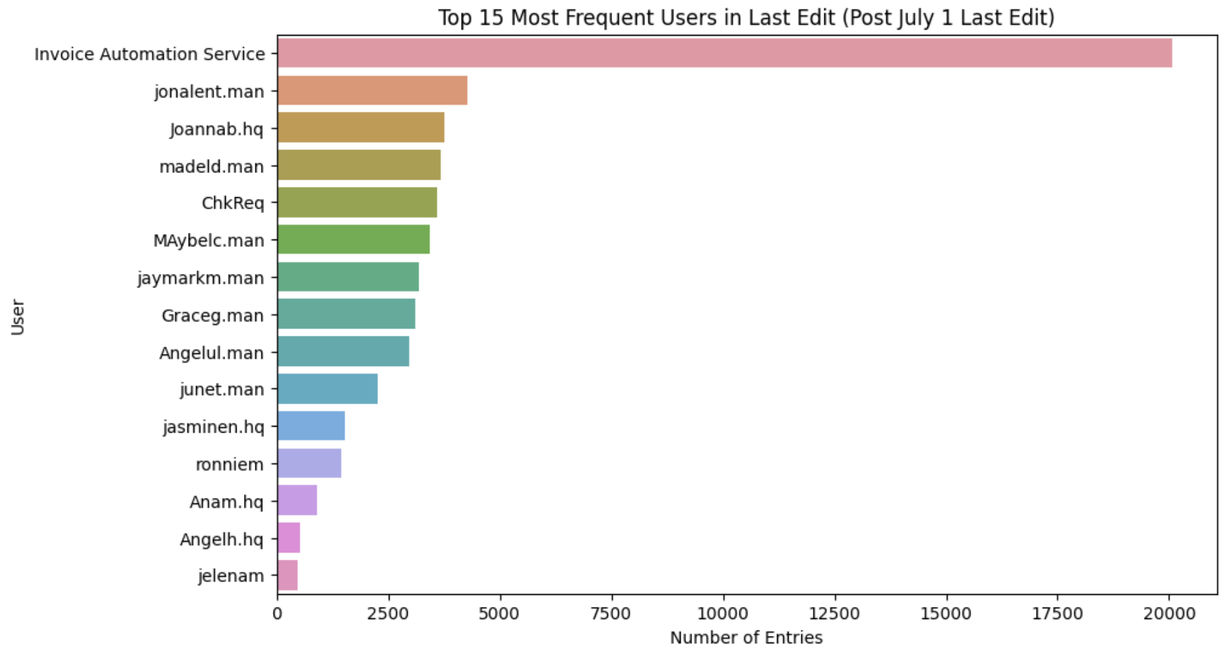
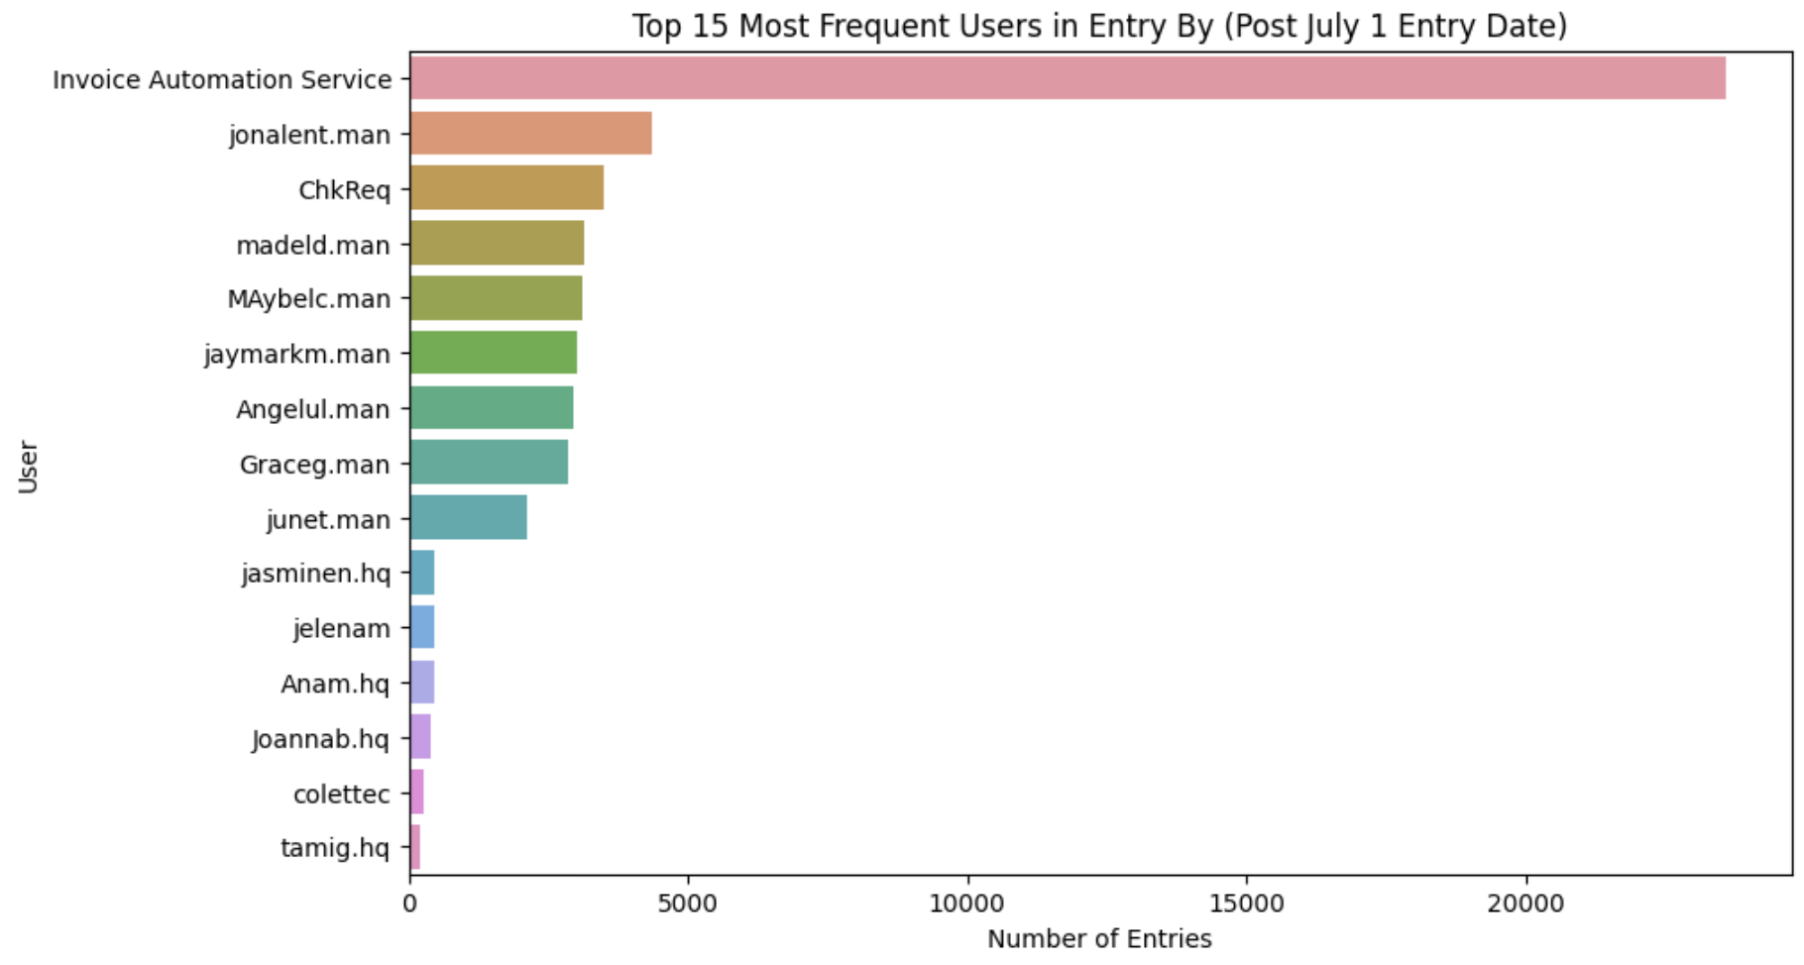
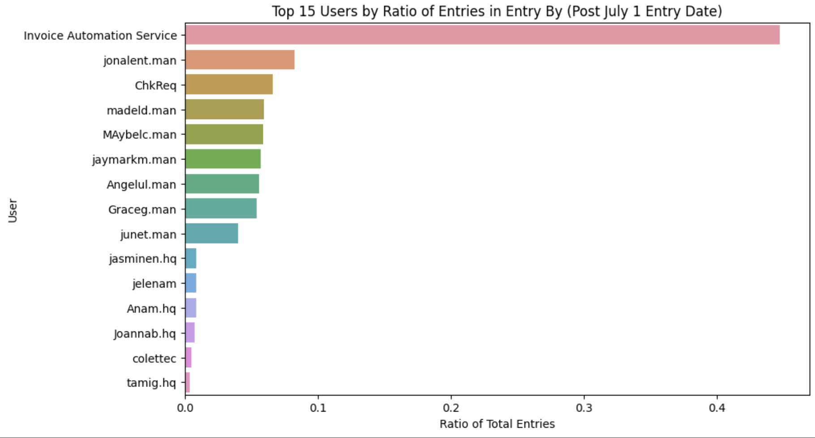
Recent Results – “Last Edit”
Invoice Automation Services - doing well!
.man still prevalent - 7/15 in top 15
Certain users without domains
ChkReq
Ronniem
Jelenam
Notes:
Ryan

Slide 7
Recent Results – “Entry By”
Invoice Automation Services - 0.45
Everyone else below 5k entries
ChkReq has jumped up to 3rd
Visible dropoff point is still in the same spot – 9th/10th range
Notes:
Ryan

Slide 8
Slowest Matching Times – Entry By
1] 'Bettyz':
Vendor No Average_Matching_Time Frequency
FEDMEM 0.0 1
HAPSEA 55.0 18
2] 'Teionf.hq':
Vendor No Average_Matching_Time Frequency
AMNJFK 150.000000 1
ANCLAX 35.993056 144
ATLACL 0.000000 1
CAOORD 17.307692 52
CBQORD 3.000000 1
COSMSY 99.000000 1
CTLJFK 15.000000 1
CTOLAX 110.857143 7
ECOMIA 108.400000 5
ECUMIA 99.000000 1
HAPSEA 43.720588 68
INDEWR 0.000000 2
MSCNOR 67.925926 27
OCGSEA 20.055556 36
OOCSEA 10.333333 3
SHIYYZ 153.500000 2
SSALGB 22.000000 1
STILGB 54.364286 140
ZFL301 0.000000 1
3] 'Dahirm.hq':
Vendor No Average_Matching_Time Frequency
AAELSE 25.000000 1
ABQABQ 12.000000 3
ACRPHX 70.333333 3
AMFDFW 43.357143 14
AVIJFK 34.000000 1
CACMIA 7.000000 1
FAXHNL 7.000000 1
PDELAX 0.000000 1
UPSJFK 56.333333 3
Notes:
Ryan

Slide 9
Slowest Matching Times – Entry By
4] 'Evanw.hq':
Vendor No Average_Matching_Time Frequency
248BNA 0.000000 1
ABFFSM 2.000000 1
ADUPHL 0.000000 2
AFEEWR 9.000000 12
AFFSEA 0.000000 1
... ... ...
TOUCVG 7.000000 1
UPSJFK 9.333333 3
USKDFW 2.000000 1
WEUSLC 1.000000 1
stisbn 118.000000 3
[74 rows x 2 columns],
5] 'Blancao.hq':
Vendor No Average_Matching_Time Frequency
ABFFSM 6.50 2
AFEEWR 74.00 3
AICIAD 6.00 1
AIWIAH 35.00 1
ASIBOS 2.00 1
FRZMCO 48.00 3
RDSONT 0.00 1
UPSJFK 5.25 4
afeewr 108.00 1}
Notes:
Ryan

Slide 10
Slowest Matching Times – Last Edit By
1] 'kathleenf.can':
Vendor No Average_Matching_Time Frequency
AEVYVR 335.571429 7
AJBYYZ 62.363636 11
2] 'chiarap2':
Vendor No Average_Matching_Time Frequency
ARMORD 62.000000 1
BRGMIA 128.000000 1
CCQLAX 16.000000 1
CEVSEA 138.000000 1
CFULAX 19.000000 1
COUMIA 62.000000 2
DRALAX 215.000000 1
EVEMCO 17.000000 1
GLOPHX 140.600000 5
LITIAD 13.000000 2
MSCNOR 7.142857 7
NEANYC 93.000000 1
ORASAN 231.000000 1
SEACHA 7.000000 1
SSFCLT 56.000000 1
STTLAX 20.000000 1
SUMPDX 147.000000 1
UPRDFW 188.000000 1
3] 'graceg.man':
Vendor No Average_Matching_Time Frequency
ABOIAD 5.500000 4
AICIAD 3.000000 1
AIWIAH 0.000000 1
ASSPIT 0.000000 1
DAYSTL 46.157895 19
... ... ...
TEDDFW 6.500000 2
THEDAY 4.333333 3
TYLPHL 9.000000 1
WPFNYC 62.000000 1
ecumia 115.000000 1
[62 rows x 2 columns],
Notes:
Ryan

Slide 11
Slowest Matching Times – Last Edit By
4] 'Paolom.hq':
Vendor No Average_Matching_Time Frequency
AEVYVR 92.000000 1
ALXSEA 104.000000 1
ARMORD 98.666667 3
CAMMSP 46.500000 2
CCULAX 61.333333 3
DAYSTL 106.333333 3
EVAMIA 118.666667 3
GRPATL 68.000000 1
ICEEWR 76.000000 2
ILLSEA 36.500000 2
ITGORD 56.000000 2
MSCNOR 24.750000 48
NOLATL 83.000000 2
OCGSEA 23.000000 1
OHIBNA 31.565217 23
PAYCLT 130.263158 19
PINDAL 37.800000 5
STILGB 44.000000 1
SUNSTL 63.000000 1
THGSEA 63.000000 1
THWATL 54.000000 1
5] 'dougb.hq':
Vendor No Average_Matching_Time Frequency
ABFFSM 69.000000 3
ACITWF 2.466667 15
BANSAT 32.000000 1
BUTEWR 62.500000 2
FIWLAX 49.500000 4
FLOCHI 49.400000 5
G4LDFW 51.000000 1
GAVDEN 38.000000 1
GLCORD 30.000000 1
GROEWR 118.000000 1
ISTBOI 39.000000 1
JPEEWR 52.000000 3
KENYYZ 147.000000 1
... ... ...
THWJFK 90.000000 2
TOUCVG 39.833333 6
TRALRD 90.000000 1
jffmke 157.000000 1
juzlax 50.000000 1}
[35 rows x 2 columns]
Notes:
Ryan

Slide 12
Potential Takeaways?
Entry By:
Top 5 slowest have relatively reasonable number of entries to deal with
High frequency vendors have average matching time ~40-60
Random outliers with <10 entries are main bulk of increased times
See AMNJFK for Teionf.hq or afeewr for Blancao.hq as examples
Last Edit By:
Most of the vendors are minimal in the number of times they show up – average appearance < 10
No real pattern of relationship between vendor occurrence and matching time
Outlier - AEVYVR has average time of 335 days
Notes:
ryan

Slide 13
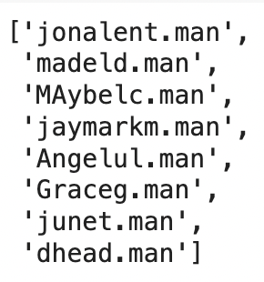
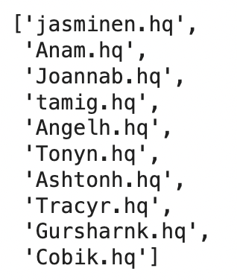
Top 10 HQ and Manila Users by Frequency for “Entry By”
Top 10 users from hq and manila by frequency in the entry by column
Less than 10 manila users in the column
Notes:
Kevin

Slide 14
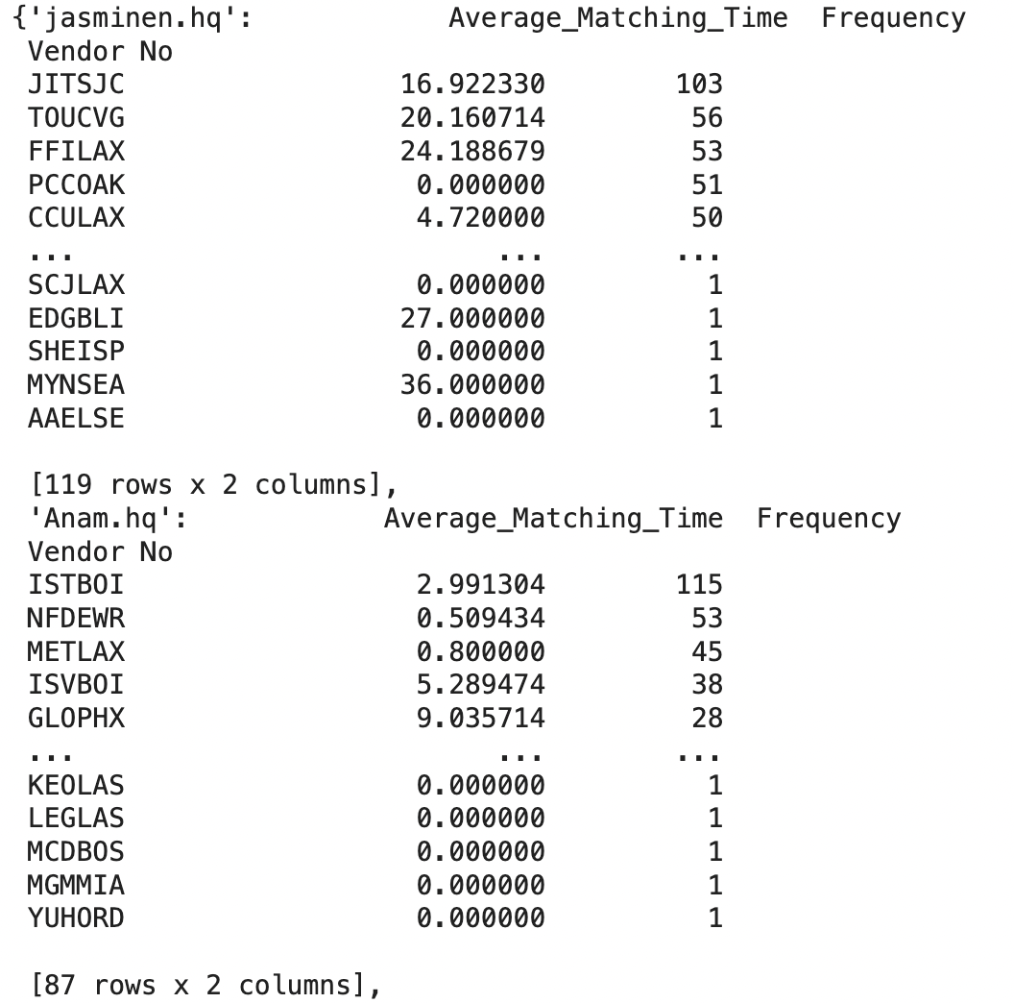
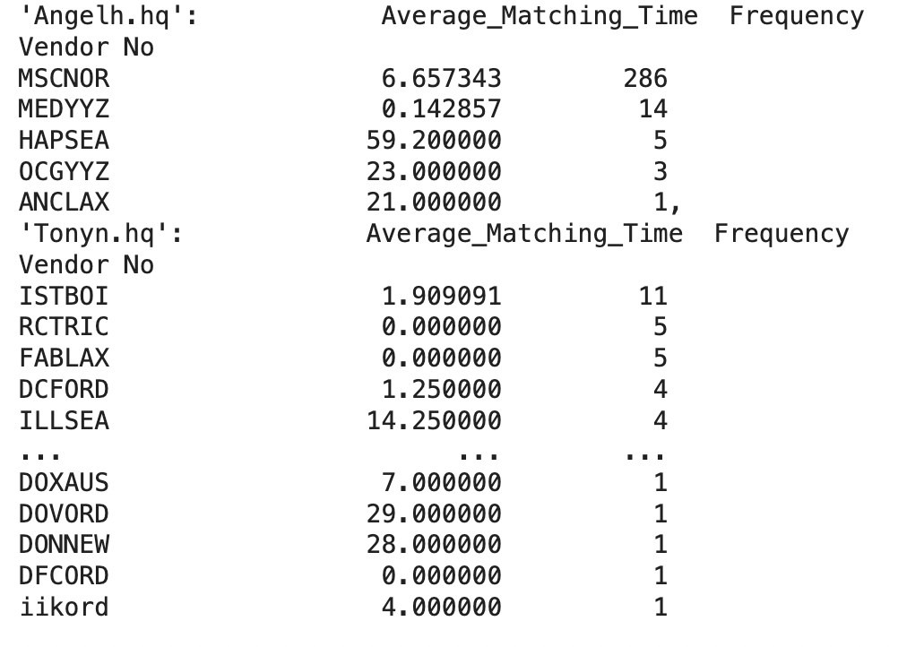
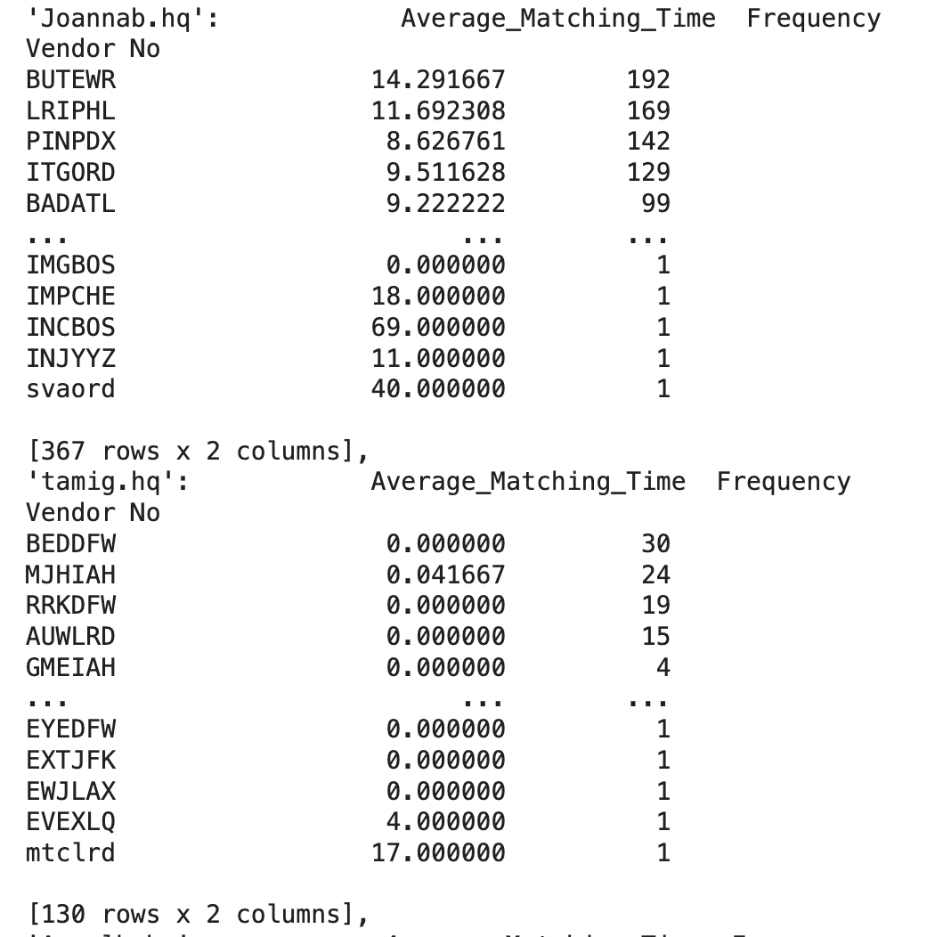
Vendor Distribution for Top 10 Users in ‘Entry By’
We determined top 10 users from hq in entry by column and their vendor distributions

Slide 15
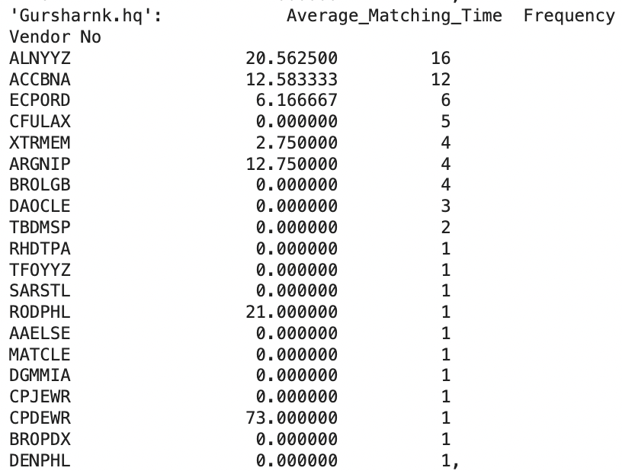
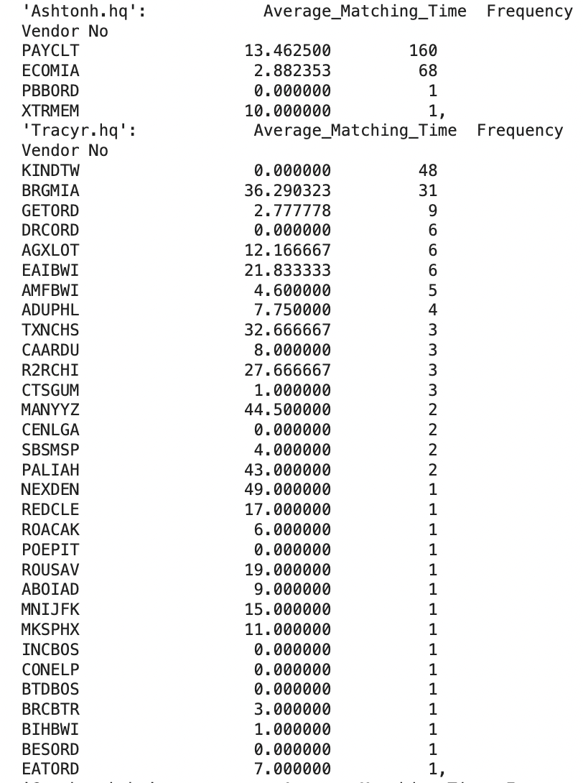
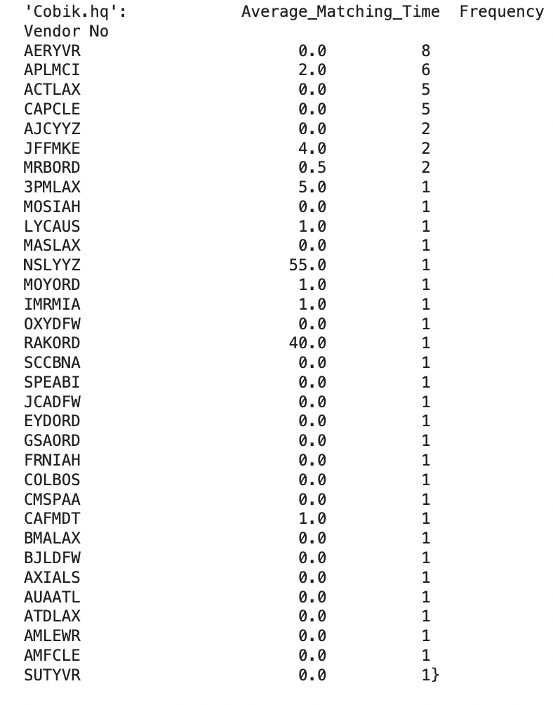
Vendor Distribution for Top 10 Users in ‘Entry By’ (cont’d)
We determined top 10 users from hq in entry by column and their vendor distributions

Slide 16
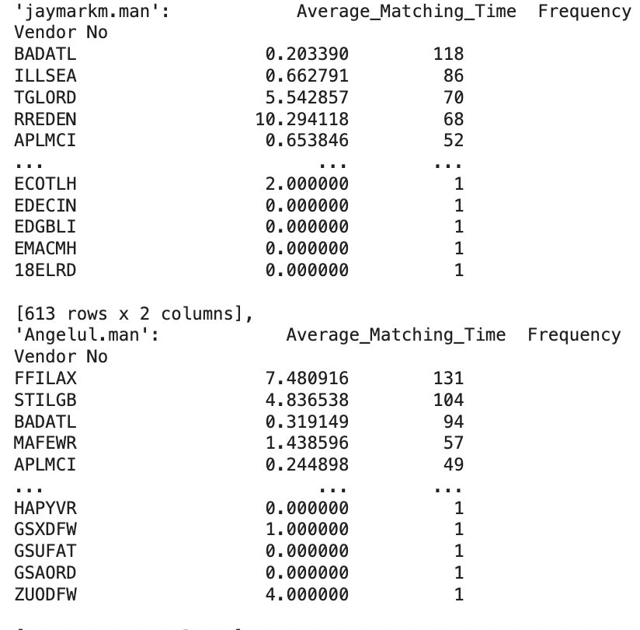
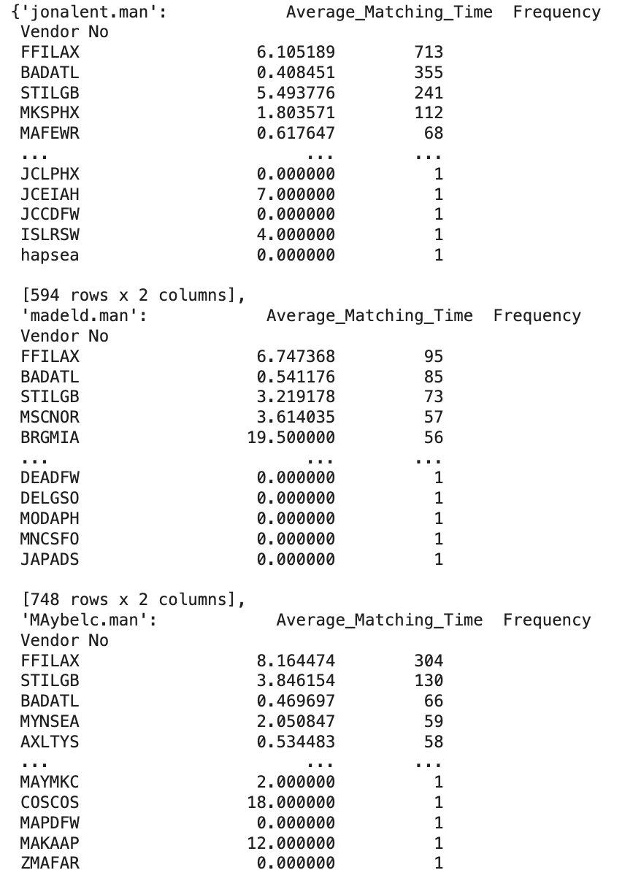
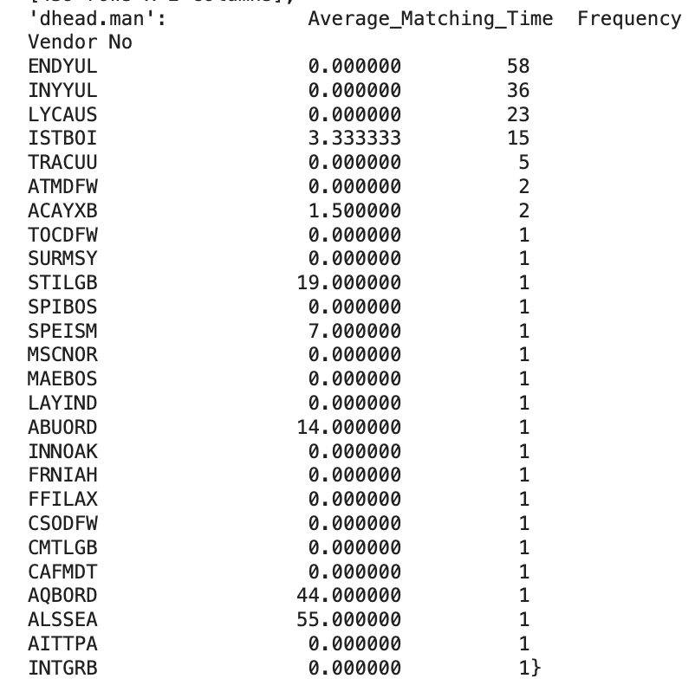
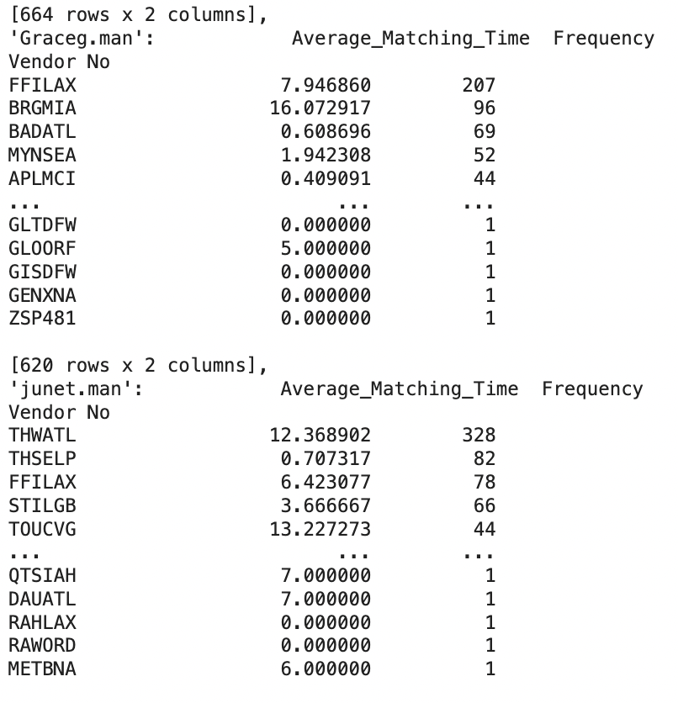
Vendor Distribution for Top 10 Users in ‘Entry By’ (cont’d)
We determined top 10 users from Manila in entry by column and their vendor distributions

Slide 17
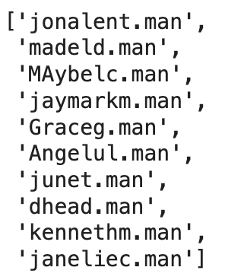
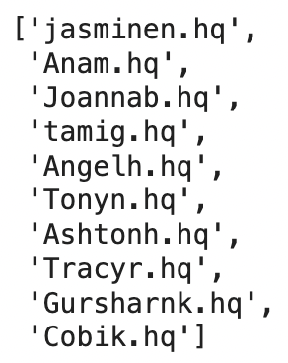
Top 10 HQ and Manila Users by Frequency for “Edit By”
Top 10 users from hq and manila by frequency in the edit by column

Slide 18
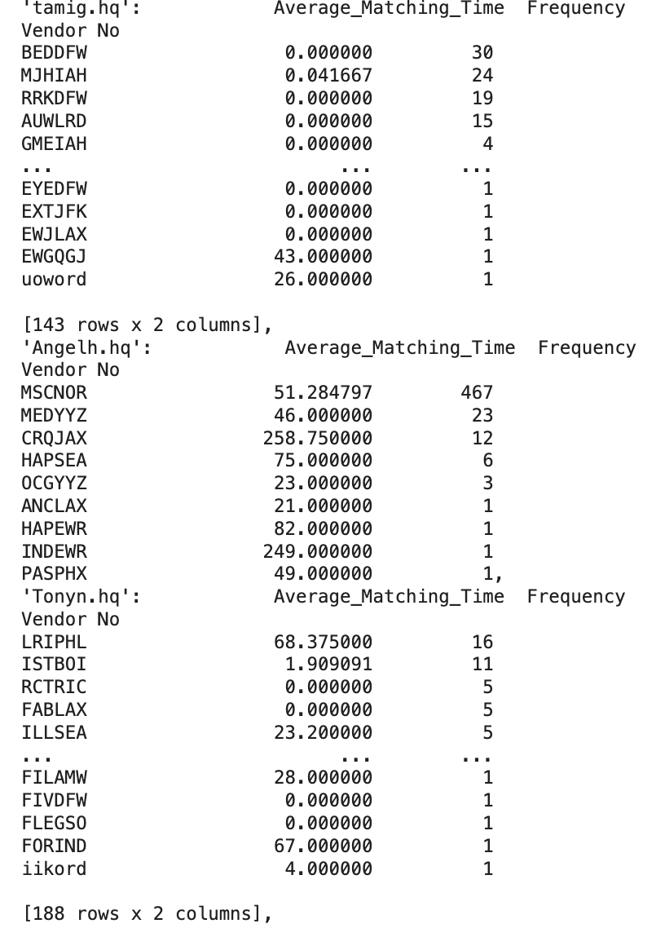
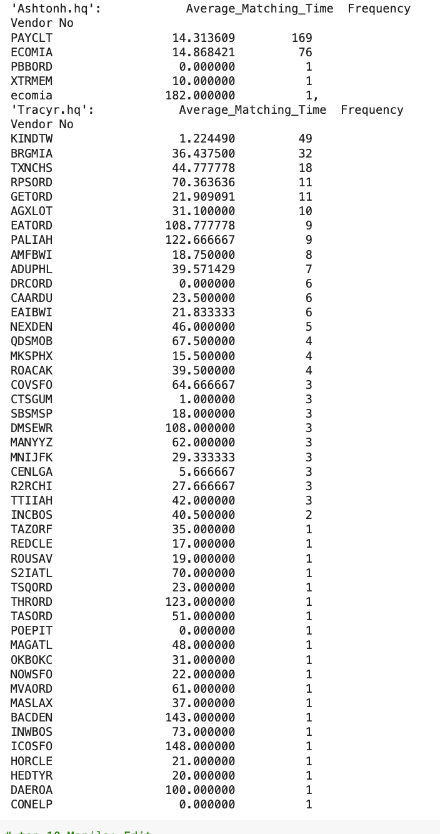
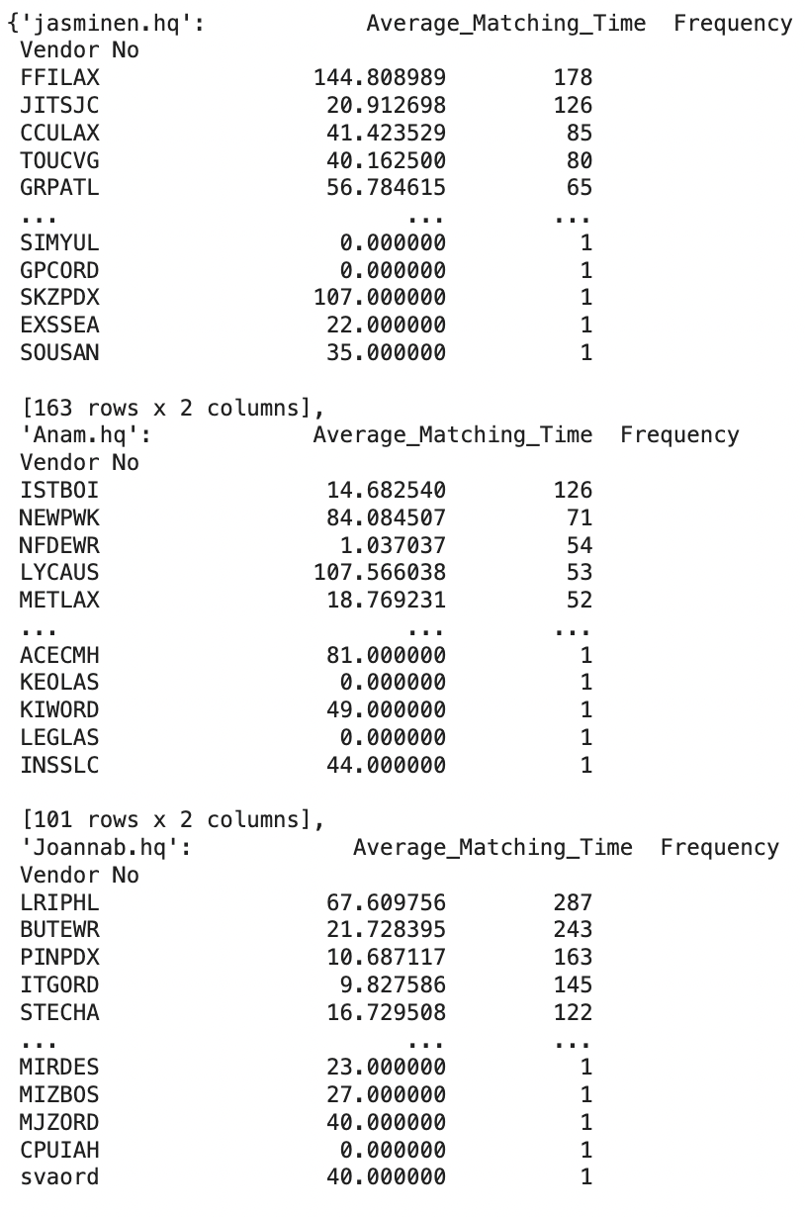
Vendor Distribution for Top 10 Users in ‘Edit By’
We determined top 10 users from hq in edit by column and their vendor distributions

Slide 19
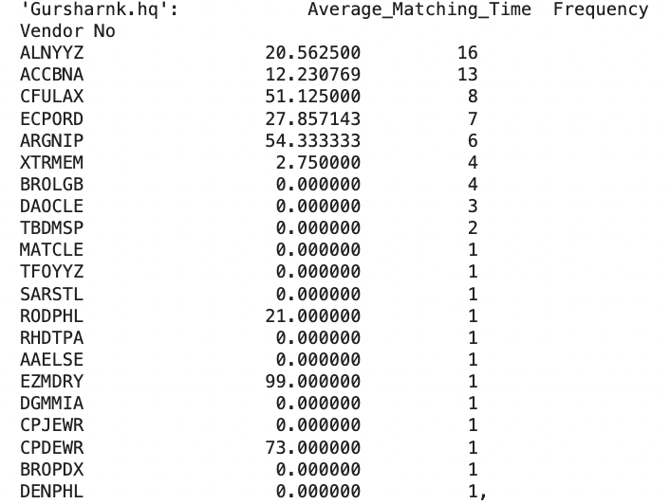
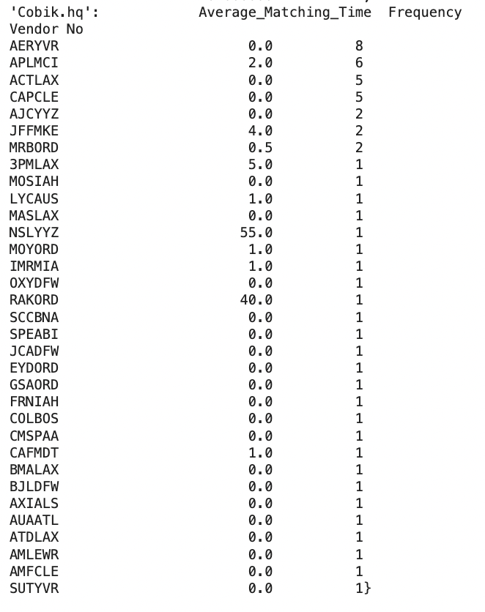
Vendor Distribution for Top 10 Users in ‘Edit By’ (cont’d)
We determined top 10 users from hq in edit by column and their vendor distributions

Slide 20
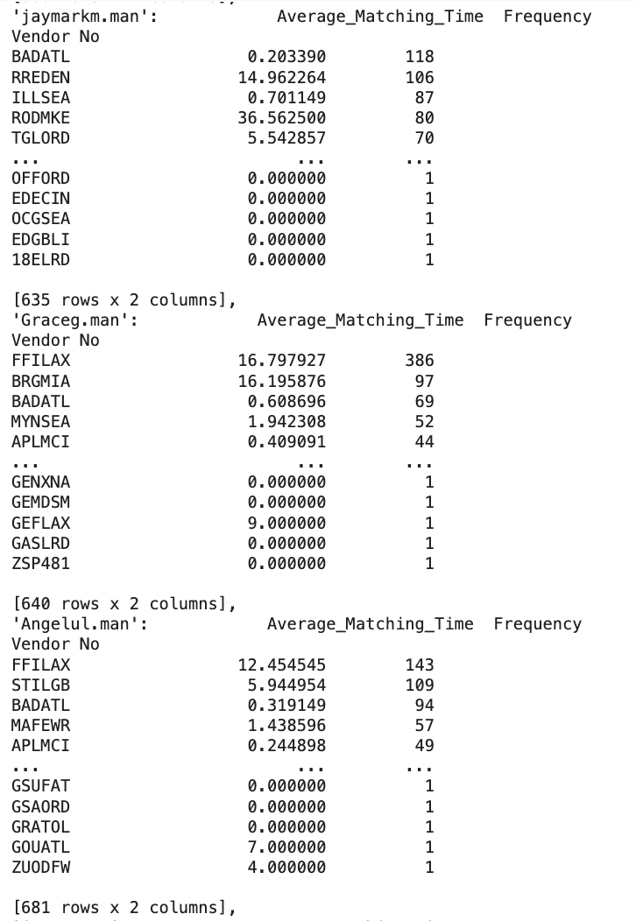
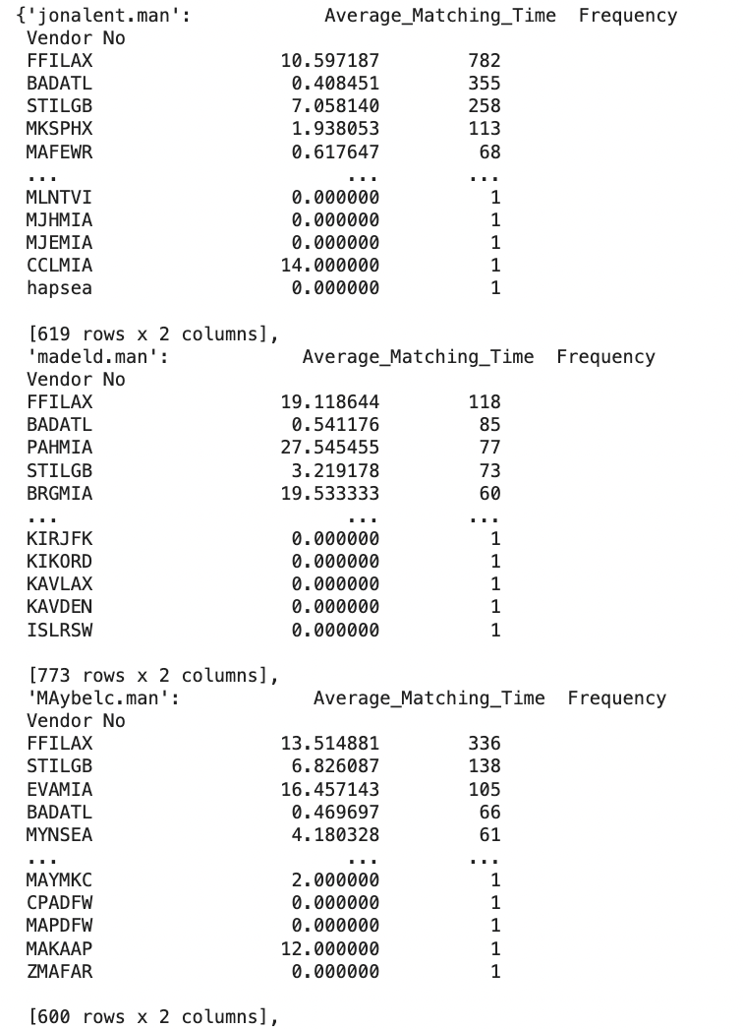
Vendor Distribution for Top 10 Users in ‘Edit By’ (cont’d)
We determined top 10 users from Manila in edit by column and their vendor distributions

Slide 21
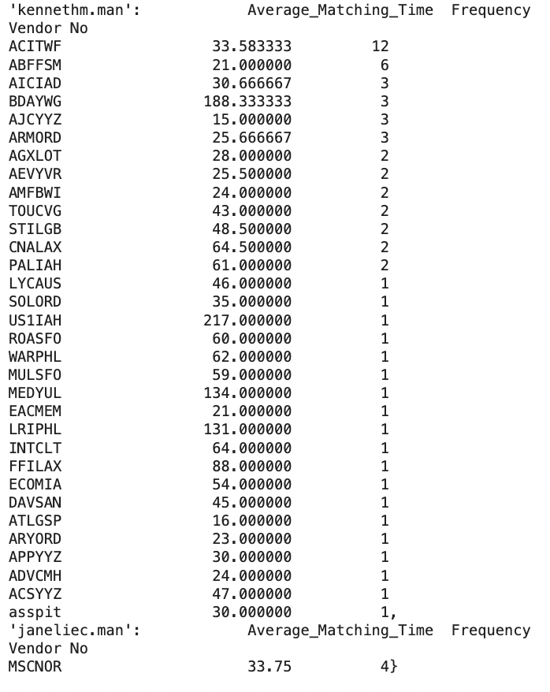
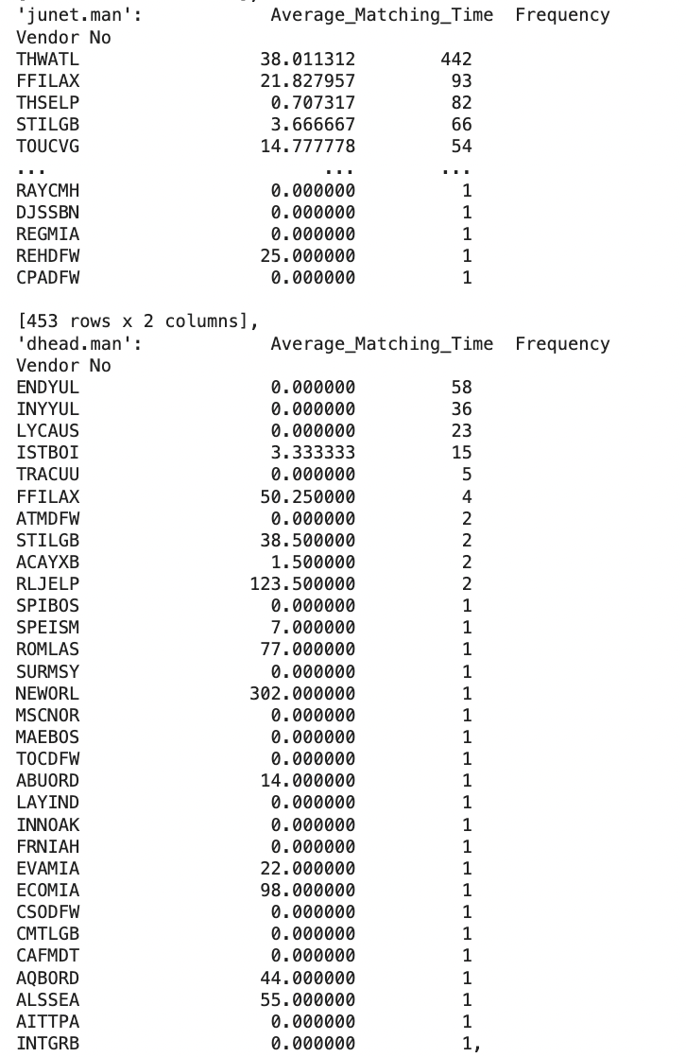
Vendor Distribution for Top 10 Users in ‘Edit By’ (cont’d)
We determined top 10 users from Manila in edit by column and their vendor distributions

Slide 22
Matching Tests: Invoices 9000-9010, 100, 14000
After data cleaning to include relevant columns (vendor number, vendor code, and features such as HWB, amount paid), analyzed the dfs “cleaned_unmatched_invoices” and “cleaned_protected_costs” to match desired invoices based on the vendor features
Checked Inv No against VendRefNo with varying string similarity parameter as low as 0.75, but found no matches
Checked PotentialMatchingHWBs against HWB with string similarity up to 0.9 after preprocessing for substrings, but found no matches (interestingly, “Total Quality Logistics” has high relevance to Inv 100), raising the question of whether vendors take different names over time

Slide 23
Matching Tests: Invoices 3000-3010, 20, 8000
Unmatched Vendor Codes (code not in protected_costs): 'CNUDFW', 'LIOORD', 'LBIDPK'
Vendors not in protected:
CNUDFW and LBIDPK not in mapping
LIOORD: Lion Logistics
Able to match with
Vendor + Amount: two invoices from HAPSEA (HAPAG-LLOYD), nothing else with even similar amounts to match
Vendor + other categories didn’t work
Vendor only - too many matches for all options
Notes:
Jade

Slide 24
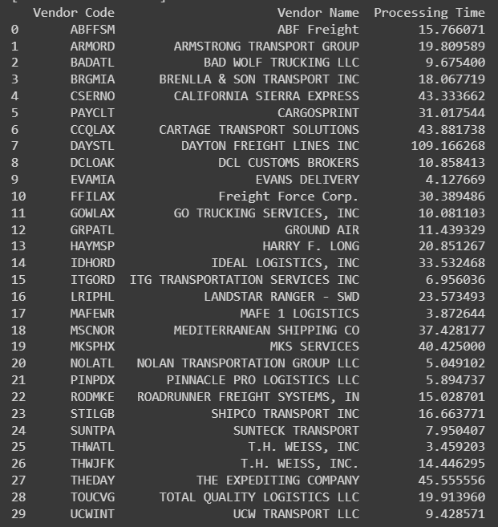
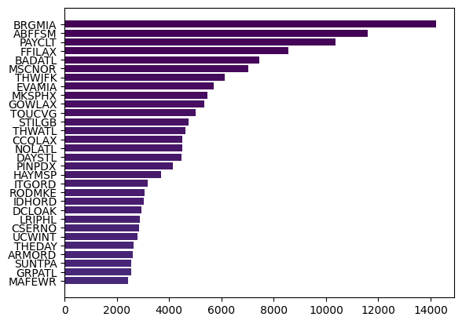
Top Vendors Info
Top 30 Vendors vs. # of Invoices
Notes:
Jade

Slide 25
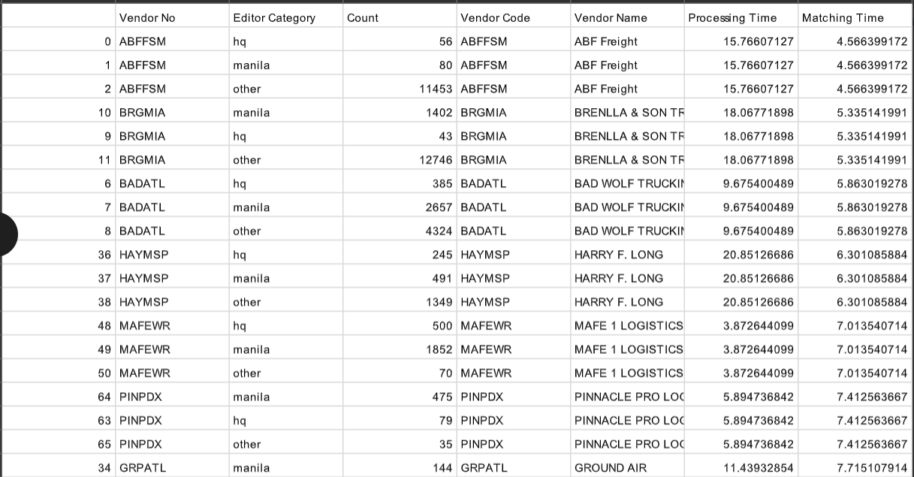
Editor/Vendor Counts + Average Vendor Times
Notes:
Jade

Slide 26
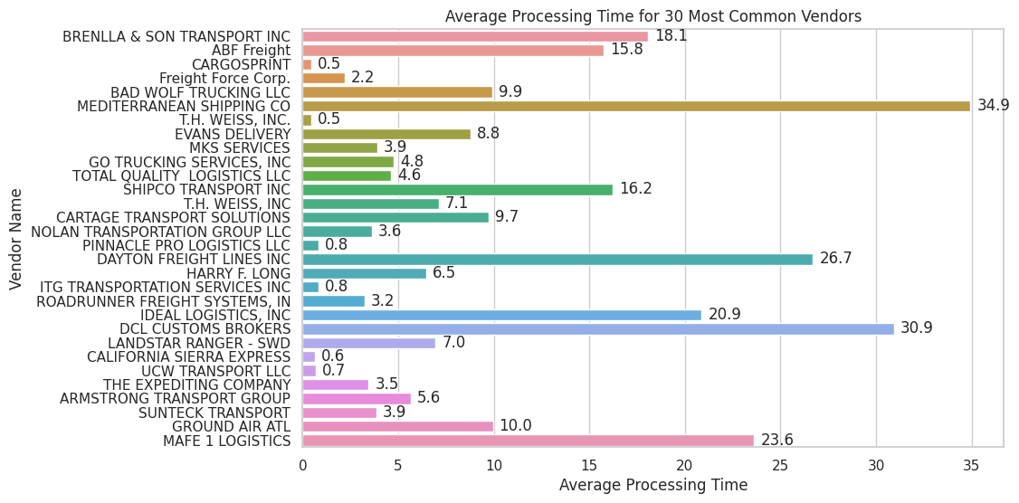
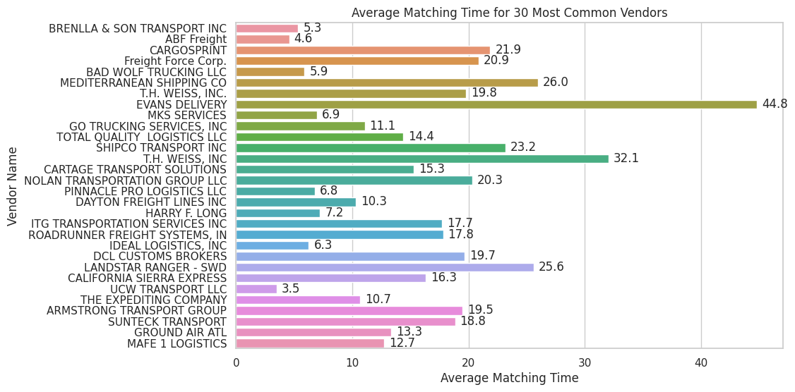
Processing and Matching Time for Top 30 Vendors
There does not seem to be a clear trend relating these measures of time and the number of invoices
Mediterranean Shipping Company seems to have both high processing and matching times
Matching times seem to be more similar than processing times

Slide 27
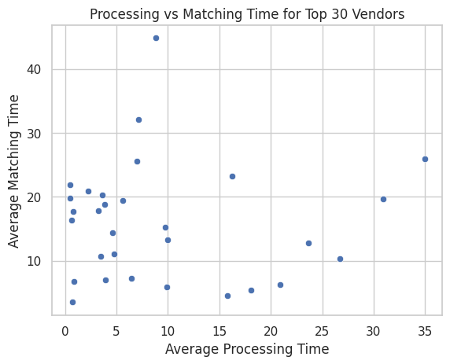
Processing and Matching Time for Top 30 Vendors (Continued)
Top vendors with lower processing time tend to have a higher matching time
Especially for those with processing times less than 1 day, this could indicate weaknesses in the automation service

Slide 28
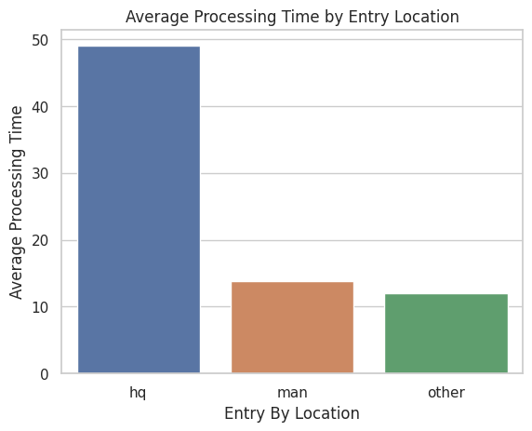
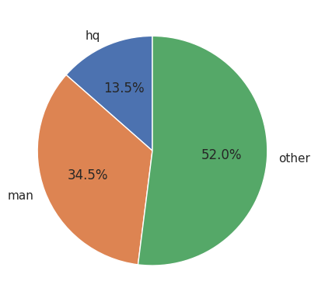
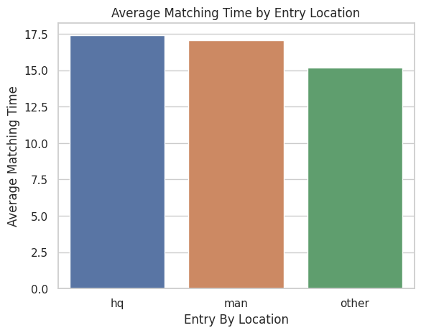
Entry Location Comparison
Invoices that were entered by users from HQ have a much higher processing time
This could imply that HQ is taking on more difficult invoices?
Matching time tends to be slightly higher for invoices entered at HQ and Manila but there is not a huge difference

Slide 29
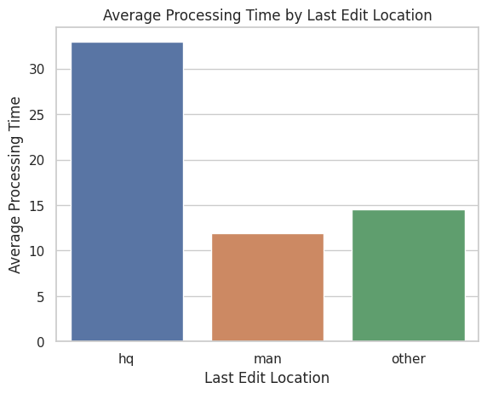
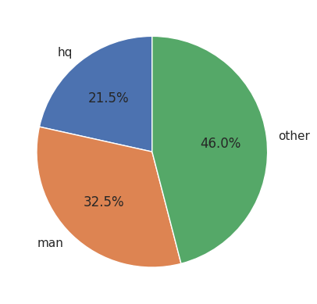
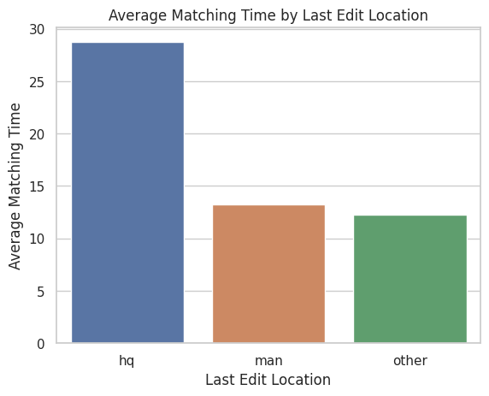
Edit Location Comparison
Invoices that were edited most recently at HQ had a much longer average processing time and matching time
This again reinforces the notion that these invoices are likely more complicated
HQ is doing more edits than entries

Slide 30
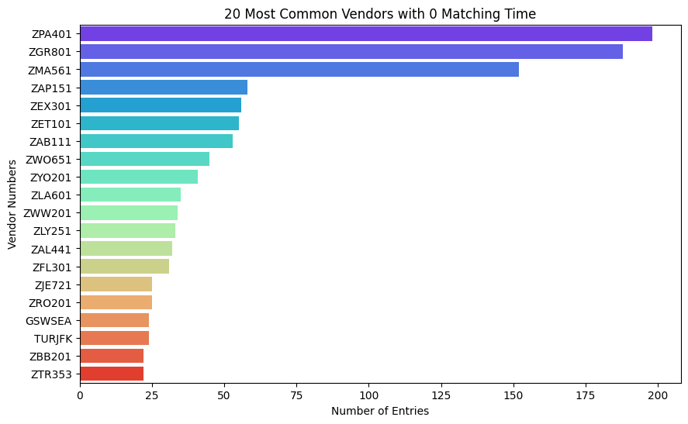
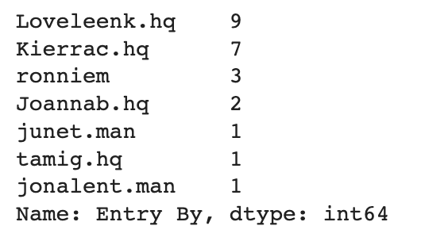
Additional Statistics 1/5
For TURJFK, all Entry By and Last Edit By are done by “lonellep” (24 entries total)
For GSWSEA, this is the breakdown of who did the entries (same as last edit because matching time = 0)
TURJFK and GSWSEA are the 2 most common vendors with 0 matching time that are processed internally
Notes:
Eliza

Slide 31
Additional Statistics 2/5
Average Matching Time table for the top 300 vendors and what percentage of these vendors in the average are above 25 days already for each of these vendors?
Table in folder: “top300_avg_matching.csv”
Percentage of vendors that are above 25 days already: 48/300 = 16%
Average Processing Time table for the top 300 vendors and what percentage of these vendors in the average are above 25 days?
Table in folder: “top300_avg_processing.csv”
Percentage of vendors above 25: 63/300 = 21%
Average Total Time (processing+matching time) for the top 300 vendors and what percentage of these vendors in the average are above 25 days?
Table in folder: “top300_avg_total.csv”
Percentage of vendors above 25 total days: 174/300 = 58%
Percentage of vendors above 50 total days: 58/300 = 19.3%
Notes:
Eliza

Slide 32
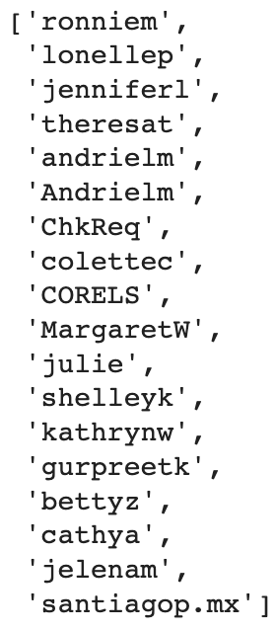
Additional Statistics 3/5
For the top 300 vendors, count the percentages of entry by/last edit by from each of the 4 possible places: hq, manilla, invoice automation service, and other
This information is in the table: top300_entryby_lastedit.csv
Moved wendyl to the hq categories- now there is also an “other” which doesn’t have name endings and the automated invoice system is its own category (see right)
The users to the right are the users that we classify into the “other” category. They are not .hq, .man, or the OCR system.
Notes:
Eliza

Slide 33
Additional Statistics 4/5
How many of the vendors cover 80% of the volume? 90% of the volume? How many vendors only come up once?
50% of the volume is made up by the top 60 vendors
80% of the volume is made up by the top 245 vendors
90% of the volume is made up by the top 500 vendors
There are 8970 total vendors
There are 5208 vendors that only appear once- that is 58% of the vendors
Notes:
Eliza

Slide 34
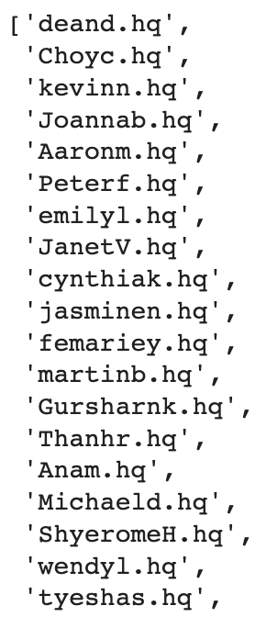
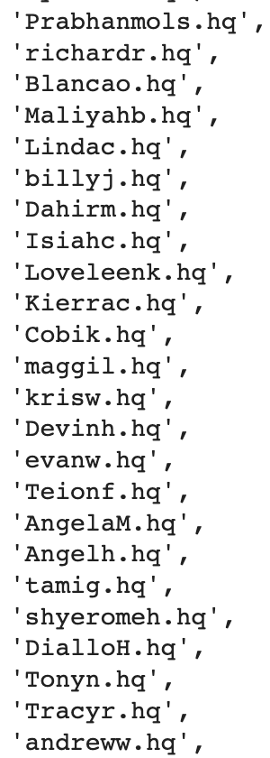
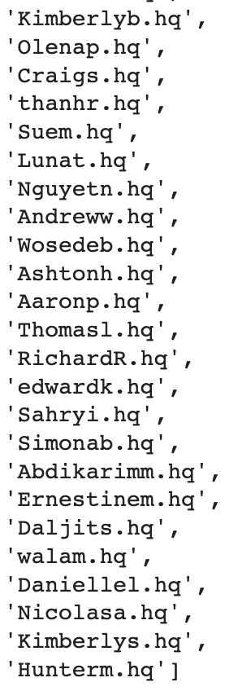
Additional Statistics 5/5
← List of all the users that end in .hq
For the people in hq, how many last edits did each person make from July-October?
Results in “hq_users_lastedit_jul-oct.csv”
Same thing done for all users
Results in “all_users_lastedit_jul-oct.csv”
Notes:
Eliza

